Slide 1
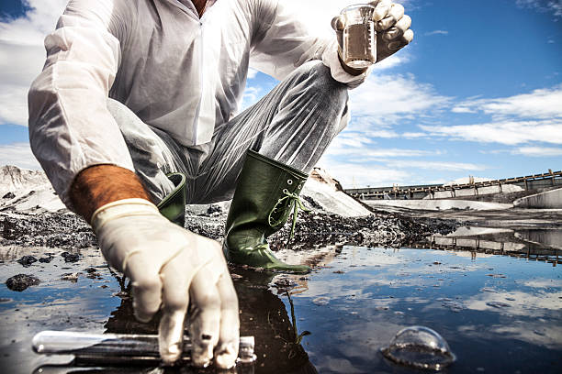
Ground water Water Quality
Regulatory Information
Cali, USA
Analytics by:
Khalid, Amna, Zainab
(Group 9)

Slide 2
Introduction
Ground water is the underground water found in soil and rock formations called aquifers which is located beneath the Earth's surface. Ground water gets there through the process of infiltration, where rainwater and surface water seep down through the soil and porous rocks.
Groundwater quality regulation aims to protect underground water resources from pollution and ensure their suitability for various uses, including drinking water, agriculture, and ecosystem support.

Slide 3
RWQCB - Regional Water Quality Control Board & CalEnviroScreen
California has nine RWQCBs, each responsible for a specific geographic region of the state.
CalEnviroScreen aims to identify communities with high pollution burdens and populations that are particularly sensitive to pollution's impacts.

Slide 4
CalEnviroScreen 3.0 vs CalEnviroScreen 4.0
The purpose use of both is the same; identifying disadvantaged communities. However, 4.0 is the updated version which includes updated demographic data and new data sources in their calculations.
CalEnviroScreen 3 Score | CalEnviroScreen 4 Score
16-20% | 35-40%
91-95% | 95-100%
36-40% | 35-40%
76-80% | 80-85%
81-85% | 80-85%
21-25% | 40-45%
66-70% | 70-75%

Slide 5
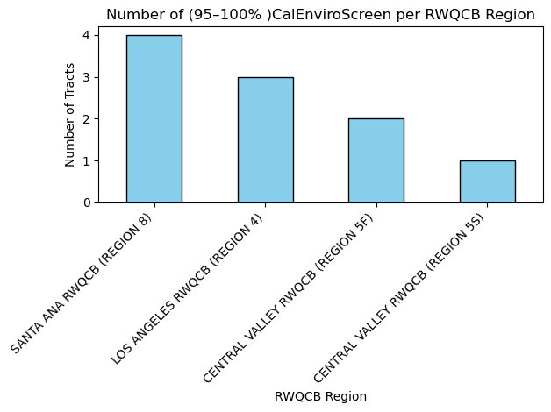
RWQCB Regions with most polluted water
This chart show the RWQCB region with the most polluted water source using the CalEnviroScreen 4.0 tool. So this means the regions shown are disadvantaged communities which can be caused by land or the population.

Slide 6
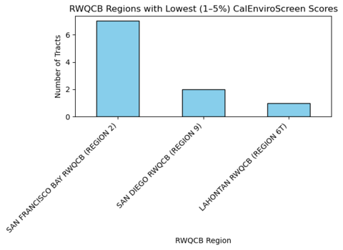
RWQCB Regions with excellent water quality
The CalEnviroScreen 4.0 score shows here the regions that have low scores that means they have no problem in their environment also the water quality is clean useable for the people

Slide 7
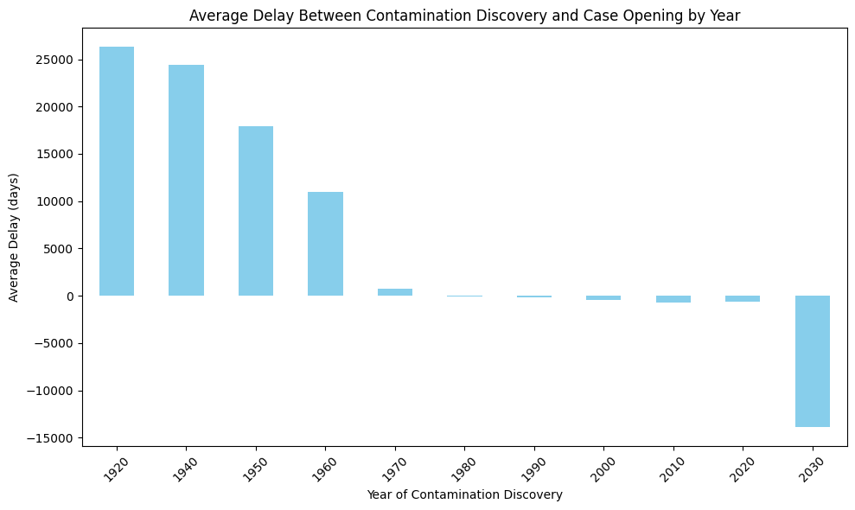
Contamination Discovery to Action
Average number of days it takes for an official case to be opened after contamination is discovered. A great improvement seen with promptness of action.

Slide 8
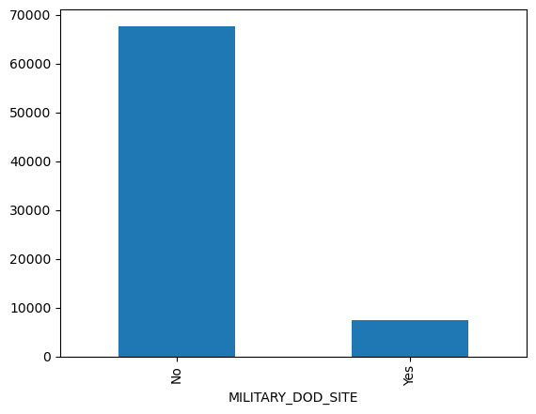
Military Sites - Least contamination
During analysis, it was found that the military sites are the least contaminated.

Slide 9
Problem Statement
Within the disadvantaged communities - a high number of contaminated areas are found, leading to difficulties in living in these areas and good quality water.
Limited access to resources, poorer health outcomes, lower educational attainment, and social isolation in contaminated areas.
The duration from the finding a leak till a claim is opened and closure is long.

Slide 10
Aims & Objectives
People’s Education - by raising awareness on sustainable practises (disposable bins for example) and how to prevent the causes of high pollution which affects the life quality and the water quality in the environment - Objective:
Frequent inspections - Increasing the site visits will lead to earlier discovery of leaks to avoid the increasing of pollution.
The use of CalEnviroScreen 4.0 - Using the updated screening tool to have accurate scores and updated demographic data to help with quicker and finding of leak locations.

Slide 11
Conclusion & Recommendations
By investing in public awareness, increasing inspection frequency, and utilizing advanced screening tools, it is possible to significantly reduce pollution, improve environmental quality, and enhance the overall well-being of communities. This holistic approach, combining preventative education with proactive detection and remediation, is essential for creating a more sustainable and healthy environment.
Implementing a comprehensive strategy to mitigate pollution that includes public education on sustainable practices and increased site inspections, leveraging the CalEnviroScreen 4.0 tool to pinpoint and address pollution sources.

